Slide 1
Azure Times #96
November 22, 2023

Slide 2
Networking

Slide 3
Networking Updates
Public preview: Enabling Rate Limiting on ExpressRoute Direct Circuits
With ExpressRoute Direct, it is possible to enable rate-limiting for circuit to match the traffic volume with the configured bandwidth rate. This allows to manage the traffic flow between on-premises network and Azure over the ExpressRoute circuit. Rate-limiting helps avoid network congestion, optimize port bandwidth usage and costs, and ensure consistent service quality.
Without this feature, or with rate-limiting disabled, the traffic over a circuit can exceed the configured bandwidth and reach the port bandwidth limit. This can affect the performance and reliability of network.
It is possible to enable rate-limiting for each circuit individually, giving the flexibility to prioritize some circuits over others within direct port. It is possible to enable this feature during or after the creation of the ExpressRoute Direct circuit.
Public preview: ExpressRoute Seamless Gateway Migration
ExpressRoute customers can now seamlessly migrate from a non-availability zone to an Availability-zone (AZ) enabled Gateway SKU.
Previously, customers were required to dismantle their existing gateway prior to setting up a new one. However, this feature provides a guided experience to seamlessly migrate circuit connections without needing to delete and recreate a new gateway. There are two cases
Increase the performance and capacity :
Standard to HighPerformance
Standard to UltraPerformance
ErGw1Az to ErGw2Az
ErGw1Az to ErGw3Az
ErGw2Az to ErGw3Az
Default to Standard
Reduce the capacity and performance
HighPerformance to Standard
ErGw2Az to ErGw1Az

Slide 4
Networking Updates
Public preview: ExpressRoute Scalable Gateway
The ExpressRoute virtual network gateway facilitates both data path and control plane connectivity to Virtual Machines and Private Endpoints over ExpressRoute. It is now possible to deploy the new ErGwScale Virtual Network Gateway SKU to achieve 40 Gbps connectivity to VMs and Private Endpoints deployed in the Virtual Network. With this SKU, it is possible to configure a minimum and maximum scale unit and Azure will auto scale the Virtual Network Gateway infrastructure, based upon active bandwidth. Additionally, it is possible to configure a fixed scale unit to achieve steady connectivity at a target bandwidth value.
ErGwScale supports both zonal and zonal-redundant deployments in Azure availability zones.
The scale operations might take up to 30 minutes to complete
Limitations
Basic IP: ErGwScale doesn't support the Basic IP SKU.
Minimum and Maximum Scale Units: It is possible to configure the scale unit for ErGwScale between 1-40.
Migration Scenarios: migration from Standard/ErGw1Az, HighPerf/ErGw2Az/UltraPerf/ErGw3Az to ErGwScale in the Public preview.
General availability: ExpressRoute Direct and Circuit in different subscriptions
ExpressRoute Direct customers will be able to manage network costs, connect ExpressRoute circuits from multiple subscriptions with one ExpressRoute direct Port resource, and isolate management of ExpressRoute Direct resource from ExpressRoute circuits.
Previously, ExpressRoute circuits and ExpressRoute Direct resources were created in one subscription, and then could connect their circuit to a Virtual Network resource that is located in a different subscription using an authorization.
With this feature today, it is possible to create the Port and ExpressRoute circuit in different subscriptions redeeming the authorizations to create a circuit.
General availability: ExpressRoute as a Trusted Service
ExpressRoute customers can now store MACsec secrets (CAK and CKN) in an Azure KeyVault with Firewall Policies enabled. This enables to restrict public access to Azure KeyVault, while allowing ExpressRoute and other Microsoft Trusted Services to access any secrets, passwords, or keys stored in the KeyVault.

Slide 5
Networking Updates
General availability: Additional Azure ExpressRoute peering locations
MS announced the expansion of our ExpressRoute services with the introduction of several new peering locations in Europe and Israel.
Zurich2
Milan2
Tel Aviv2
MS will be discontinuing the ExpressRoute peering location in Bogota.
Public preview: Customer-controlled maintenance
Now it is possible to configure maintenance windows to schedule gateway maintenance at a time that is most convenient for their business. Currently customer-controlled maintenance windows are available in public preview for 4 types of gateway resources: (1) Virtual Network Gateway in ExpressRoute service (2) Virtual Network Gateway in VPN Gateway service (3) VPN Gateway (Site-to-Site) in Virtual WAN service (4) ExpressRoute Gateway in Virtual WAN service.
Public preview: Private subnet
Currently, when virtual machines are created in a virtual network without any explicit outbound connectivity, they are assigned a default outbound public IP address. These implicit IPs are subject to change, not associated with a subscription, difficult to troubleshoot, and do not follow Azure's model of "secure by default" which ensures customers have strong security without additional steps needed. (The depreciation for this type of implicit connectivity was recently announced and is scheduled for September 2025.)
The private subnet feature will let prevent this insecure implicit connectivity for any newly created subnets by setting the "default outbound access" parameter to false.
The parameter to create a Private Subnet can only be modified during the creation of a subnet.
VMs on a Private Subnet can still access the Internet using explicit outbound connectivity
Certain services will not function on a virtual machine in a Private Subnet without an explicit method of egress (examples are Windows Activation and Windows Updates)
.

Slide 6
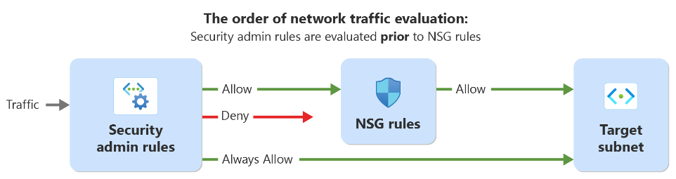
Networking Updates
Azure Virtual Network Manager Security Admin Rule generally available in select regions
This feature lets enforce security policies for virtual networks (VNets) at scale across subscriptions and regions globally. These rules will be evaluated before network security groups (NSGs), ensuring standardized security enforcement. They help prevent potential misconfigurations and oversights, making sure that critical services run without interruption and that network owners adhere to company policies.
Security admin rules allow users to manage security efficiently, reducing operational complexities. They also offer a default setting to avoid errors or oversights in setting up NSGs. As such, users can simplify and enhance their network security for their growing network environments.

Slide 7
Security & Identity

Slide 8
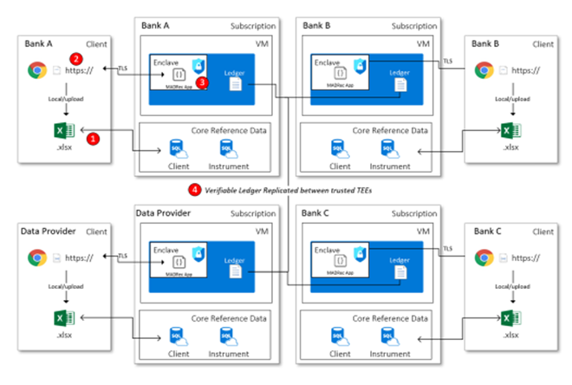
Security & Identity Updates
Public Preview: Announcing the preview of Azure Managed Confidential Consortium Framework
Customers can now build and host decentralized governance applications in an Azure hosted, managed environment with the infrastructure of Azure confidential computing underneath. These decentralized applications leverage the Confidential Consortium Framework’s principles: decoupling the transaction computations, executed within Trusted Execution Environments (TEEs), from the framework governance. Such an architecture allows for the set of nodes executing the transactions to do so without access to the contents and are ideal for building applications with programmable confidentiality on data and information that might be needed between multiple parties. The product has applicable scenarios in financial services, banking, healthcare and other regulated industries.
Preview: New Basic SKU functionality for Azure confidential ledger
Azure confidential ledger is launching a Basic SKU to serve customers of other Azure products needing higher integrity protection. The Basic SKU will have limited transactions per second compared to the Standard SKU. It is ideal for cases where periodic hash digests are sent to the Azure confidential ledger for advanced integrity protection of your main data source. The Basic SKU will be free of charge for the duration of the gated preview.

Slide 9
Security & Identity Updates
Microsoft Announces General Availability of Defender for APIs
MS announced the General Availability of Microsoft Defender for APIs, designed to protect organizations against API security threats. Defender for APIs offers full lifecycle protection, detection, and response coverage for organizations’ managed APIs.
Defender for APIs helps to get:
Gain a unified inventory and aggregated view of all Azure API management in a single dashboard.
Classify APIs that handle sensitive data and supporting risk prioritization.
Harden API configurations and easily assess API gateway for security best practice controls.
Address Security recommendations to identify unused and unauthenticated APIs.
Assess API security findings in Cloud Security Explorer and API attack path analysis.
Gain a comprehensive coverage of the OWASP API Top 10 threats, including data exfiltration and volumetric attacks.
Leverage workflow automations to action on your API security recommendations and findings.
Stay up to date with API Security workbook that provides summary of posture findings and security alerts.
Seamlessly integrate with Microsoft Sentinel and other popular SIEM solutions for efficient threat remediation.
Defender for Cloud Updates
General Availability of GCP capabilities in Defender CSPM
General Availability of the data security dashboard provides a centralized view of risks to sensitive data across datastores.
General Availability of sensitive data discovery for Azure SQL databases and AWS RDS instances in Defender CSPM.
General Availability of the Azure Monitoring Agent (AMA) auto provisioning process for Defender for SQL servers on machines plan.
Public preview of malware download detection in Defender for Storage alerts of malware distribution events where an infected blob has been detected.
Accelerated critical risk remediation with Microsoft Security Copilot integration
Integrated security across multiple DevOps platforms
Improved API Security Posture

Slide 10
Security & Identity Updates
Microsoft Entra + Security Copilot
Microsoft Security Copilot is coming to Microsoft Entra to help automate common tasks, troubleshoot faster, interpret complex policies, and design workflows.
It will be possible to ask the Copilot about all related issues and problems
Microsoft’s Security Service Edge (SSE) solution
Microsoft’s Security Service Edge (SSE) solution, now in preview, includes Microsoft Entra Internet Access and Microsoft Entra Private Access, and secures access to any app or resource for users and devices connecting from anywhere.
Microsoft Entra Permissions Management
Microsoft Entra Permissions Management has two significant integrations:
Integration with Defender for Cloud
Integration with SNOW

Slide 11
Management & Governance

Slide 12
Management & Governance Updates
Public Preview: Azure Monitor Agent JSON log collection
Azure Monitoring Agent now supports collection of JSON for ingestion into Log Analytics.
MS announced the public preview JSON Log collection for AMA. This new capability is designed to enable customers to collect their JSON formatted logs generated in their service or application and ingested into a Log Analytics Workspace table for analysis.
You must be using the AMA agent to use custom JSON logs.
General Availability of Azure Backup for AKS
Azure Backup for AKS, a simple, cloud-native solution that enables to protect AKS clusters via backing up Kubernetes workloads deployed along with the application data.
Currently, AKS backup supports once-a-day backup.
AKS backup uses a blob container and a resource group to store the backups.
Currently, AKS backup supports Azure Disk-based persistent volumes (enabled by CSI driver) only
General availability: Reservations for Microsoft Fabric
MS announced reservation pricing for Microsoft Fabric that will allow to pre-commit to Fabric Capacity Units in one-year increments, helping save up to 40.5 percent over the pay-as-you-go prices (excluding Power BI Capacity SKUs).
Public preview: 3rd party support for Arm solutions in Azure Marketplace
Azure publishers can now add Arm64-based solutions the Azure Marketplace, in addition to x64 products and tailor their infrastructure based on customer needs. With this feature, partners can now support multiple architectures at the same time, including Arm. With this new capability, the customer can now deploy the Arm-based images from the Azure Marketplace and benefit from the rich and vibrant ecosystem developing around Arm-based Azure infrastructure. This facilities the growth of the Arm ecosystem within Azure and unlocks new workflows and possibilities for developers building on Arm-based platforms.

Slide 13
Management & Governance Updates
Public Preview: Azure Monitor Alerts integration with Event Grid for Azure Key Vault system events
Alerts help detect and address issues before users notice them by proactively notifying when Azure Monitor data indicates there might be a problem within infrastructure or application.
Azure Monitor alerts as a destination in Event Grid event subscriptions allow to receive notification of critical events via action groups as Short Message Service (SMS), email, push notification, and more.
Announcing GA: Multi-Line Logging in Azure Monitor - Container Insights
MS announced the General Availability of Multi-Line Logging in Azure Monitor – Container Insights. Multi-Line Logging is a new way to simplify and streamline Log Analysis in Azure Monitor. This feature allows to collect and store multiple lines of log data in a single log entry, making it easier to view and analyze logs from your containerized applications.
Export cost details using the FinOps Open Cost and Usage Specification (FOCUS)
The FinOps Open Cost and Usage Specification (FOCUS) is a groundbreaking initiative to establish a common provider and service agnostic format for billing data that empowers organizations to better understand cost and usage patterns and optimize spending and performance across multiple cloud, software as a service (SaaS), and even on-premises service offerings. Microsoft Cost Management is introducing support for cost and usage data exports aligned to the FOCUS schema as part of a limited preview leading up to the next major FOCUS release.

Slide 14
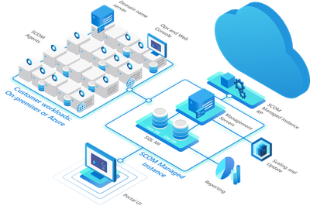
Management & Governance Updates
Announcement: Azure Monitor SCOM Managed Instance is now Generally Available!
Azure Monitor SCOM MI is now GA and helps easily lift and shift existing on-premises monitoring investments to Azure Monitor, helping modernize and speed up migrations.
Public preview of Azure Stack HCI version 23H2
Azure Stack HCI version 23H2, core lifecycle operations like deployment, patching, configuration, and monitoring are performed entirely from the cloud, reducing the need for on-site tools and personnel.
Cloud-based deployment
Cloud-based update management
Cloud-based monitoring
Central management for all your workloads
Azure Migrate VMs migration from VMware or Hyper-V to Azure Stack HC
Azure Virtual Desktop for Azure Stack HCI (preview)
Trusted launch for Azure Arc-enabled virtual machines

Slide 15
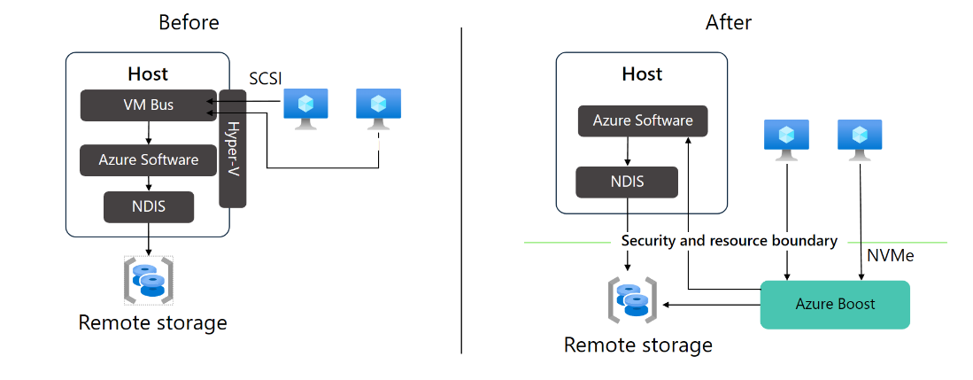
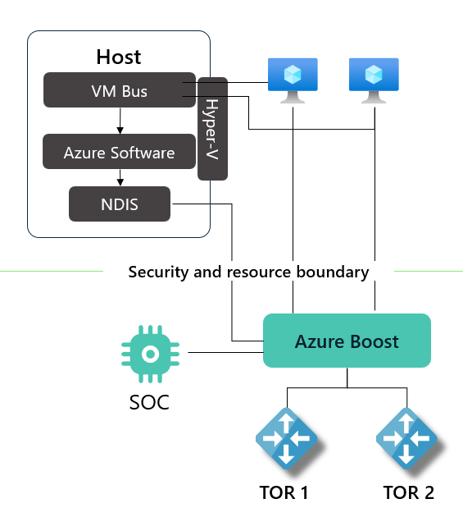
Management & Governance Updates
GA: Azure Boost
Azure Boost is a system designed by Microsoft that offloads server virtualization processes traditionally performed by the hypervisor and host OS onto purpose-built software and hardware. This offloading frees up CPU resources for the guest virtual machines, resulting in improved performance. Azure Boost also provides a secure foundation for your cloud workloads. Microsoft's in-house developed hardware and software systems provide a secure environment for your virtual machines.
Storage:
Storage operations are offloaded to the Azure Boost FPGA. This offload provides leading efficiency and performance while improving security, reducing jitter, and improving latency for workloads. Local storage now runs at up to 17.3-GBps and 3.8 million IOPS with remote storage up to 12.5-GBps throughput and 650 K IOPS.
Networking:
Azure Boost includes a suite of software and hardware networking systems that provide a significant boost to both network performance (Up to 200-Gbps network bandwidth) and network security. Azure Boost compatible virtual machine hosts contain the new Microsoft Azure Network Adapter (MANA).

Slide 16
Management & Governance Updates
Public Preview: New Marketplace app for Storage customers and feature enhancements to portal for Azure confidential ledger
Azure storage customers will now be able to use an Azure confidential ledger Marketplace application to further protect their blob data. Data signatures from blob can be harvested and stored in a confidential ledger for tamper protection. At a later point in time and to demonstrate tamper proofness for compliance and auditing purposes, signatures can be recalculated and validated against the signature in Azure confidential ledger.
Next, the Azure confidential ledger Portal experience has been improved with a new Ledger Explorer feature that allows observing transactions and validating the cryptographic proofs of ledger transactions. The multi-admin delete upcoming feature will allow deleting ledgers only with approval from multiple administrators, compared to a single administrator requested delete today.
General availability: Integration of Azure Monitor Agent support with Connection Monitor
Connection Monitor, a multi-agent monitoring solution, detects network connectivity and performance errors real time with aggregated packet loss and latency, localizes the problematic network component with end-to-end path visibility in unified topology and provides actionable insights to diagnose and troubleshoot the issues, thus reducing the overall Mean Time to Resolve network connectivity issues.
With Azure Monitor Agent, MS aim to consolidate multi-monitoring agents into a single agent. This capability addresses connectivity monitoring logs and metrics data collection needs across Azure and ARC enabled on-premises machines, thus eliminating the overhead of management and enablement of multiple monitoring agents. Additionally, Azure Monitor Agent provides enhanced security and performance capabilities, effective cost savings & ease of troubleshooting with simpler management of data collection.
Connectivity monitoring support for ARC enabled on-premises endpoints as source as well as destination.
Simpler management of network monitoring extensions
One agent for monitoring Azure and non-Azure Arc endpoints
Enhanced security through Managed Identity and Azure Active Directory (Azure AD) tokens

Slide 17
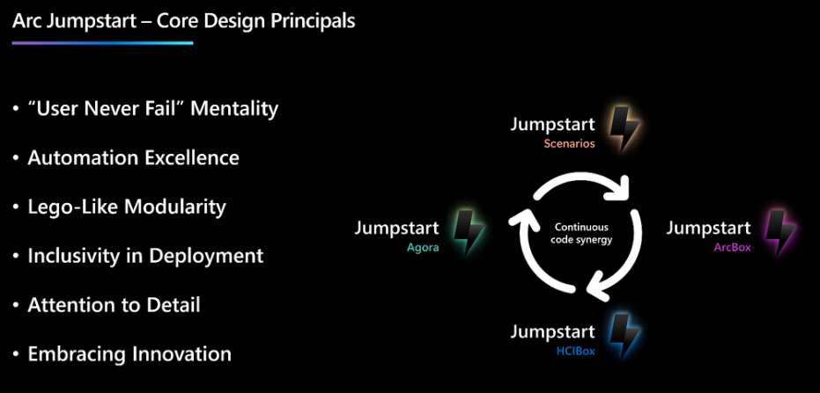
Management & Governance Updates
Azure Migrate updates
Envision readiness and cost (TCO): Customers moving to the cloud often struggle with decisions around management tools and associated costs. Azure Migrate business case feature will include management cost and savings for services such as Azure Backup, Azure Update Manager and Azure Monitor. This is in addition to security readiness and cost for Microsoft Defender for Cloud (MDC) and Windows and SQL Server with ESU.
New workloads: Azure Migrate now allow to assess readiness and estimate cost for Spring web apps moving to Azure Spring Apps and ASP.NET on Internet Information Server (IIS) to App Service Container.
End-of-support (EOS) and Extended Security update (ESU) support:Azure Migrate will now support in-place upgrade of end-of-support (EOS) Windows Server 2008 R2 and later operating systems (OS).
Application and code assessment: Determine health and cloud readiness of your .NET and Java applications using the deep insights provided by the new “Azure Migrate application and code assessment” feature.
Bring Azure to your System Center environment: Announcing GA of SCVMM enabled by Azure Arc
MS announced that System Center Virtual Machine Manager (SCVMM) enabled by Azure Arc is now generally available to manage SCVMM resources in Azure.
With SCVMM enabled by Azure Arc, it is possible to:
Enable Azure service at scale for entire SCVMM managed on-premises estate
Enable self-service access and management to SCVMM resources for developers and end users
Arc Jumpstart Next

Slide 18
Management & Governance Updates
Azure Business Continuity Center
Centralized Views and Operations: It provides single centralize view, monitor, govern, and audit compliance for protected items across various solutions and environments, including Azure and hybrid setups.
Unified Monitoring: It provides holistic visibility and actionable insights into their BCDR estate which significantly reduces the time
BCDR coverage: for Security provides proactive assessment capability for the configuration and able to quickly identify gaps in security settings.
Governance and Audit Compliance: provides and maintain regulatory compliance and optimizing costs

Slide 19
Compute

Slide 20
Compute Updates
General Availability: Ubuntu Server to Ubuntu Pro in-place upgrade now available
Upgrade to Ubuntu Pro by adding an Ubuntu Pro subscription to Azure VMs without redeploying or taking VMs offline. Ubuntu Pro comes with 10 years of support for 2,300 Main and 23,000+ Universe packages (18.04 recently entered extended support).
Public preview: New Generation AMD VMs - Dasv6/Easv6/Fasv6
Azure introduces the latest AMD-based VMs in public preview for the D, E, and F family VMs, built on the 4th Generation AMD EPYC™ 9004 (Genoa) CPU. These new VMs introduce even greater performance and reliability than the previous AMD v5 VMs based on the 3rd Generation AMD EPYC™ (Milan) CPU. These new Genoa-based VMs will come in the form various series of different memory to core ratios spread across of the three VM families – the general purpose Dasv6 and Dalsv6 series, the memory optimized Easv6 series, and the compute optimized Fasv6, Falsv6, and Famsv6 series.
The new VMs are also powered by Azure Boost and come with NVMe interface for local and remote disks. Workloads can see up to 80% better remote storage performance, 400% faster local storage speeds, and 20% networking bandwidth improvement over the previous generation of AMD-based VMs.
These new VMs significantly expand the VM options available for customers of Azure AMD VMs, spanning a multitude of popular VM series of varying memory sizes and budgets.
Public preview: Azure VMSS Zonal Expansion
Azure VMSS Zonal Expansion empowers users to transition their regionally configured virtual machines (VMs) into a zonal configuration across Azure availability zones. This translates to an impressive boost in business continuity, resilience, and an increase in availability Service Level Agreement (SLA) from 99.95% to a promising 99.99%.
This feature allows to modify a virtual machine scale set (VMSS) to expand the set of zones over which to spread VM instances. New instances will be evenly and explicitly spread across availability zones.
This preview is supported for VMSS stateless infrastructure workloads that do not need to preserve disks or network resources. It is not supported for scale sets with stateful workloads or used with Service Fabric or Azure Kubernetes Services.
az vmss update --set zones=["1","2","3"] -n myScaleSet -g myResourceGroup

Slide 21
Compute Updates
Public preview: VM Hibernation
It is now possible to hibernate VMs to save compute costs. When VM is hibernated, Azure persists the VM’s in-memory state in the OS disk and deallocates the VM. As a result, you don’t have to pay for the VM when its hibernated and you only pay for any storage and networking resources associated with the VM. When you later start the VM, the applications and processes that were previously running resume from their previous state, allowing you to quickly pick up from where you left off.
Hibernating VMs is an effective cost management feature for scenarios such as:
Virtual desktops, dev/test
Prewarmed VMs
Note:
Data in the temporary disk isn't persisted.
Hibernation support is limited to certain VM sizes and OS versions (General Purpose Intel and AMD VM Sizes)
Hibernation isn't supported with Trusted Launch for Linux VMs
You can't enable hibernation on existing VMs.
You can't resize a VM if it has hibernation enabled.
When a VM is hibernated, you can't attach, detach, or modify any disks or NICs associated with the VM. The VM must instead be moved to a Stop-Deallocated state.
When a VM is hibernated, there's no capacity guarantee to ensure that there's sufficient capacity to start the VM later.
Hibernation is enabled on your VM when creating the VM.
You can't disable hibernation on a VM once enabled.
Azure feature limitations
Ephemeral OS disks
Shared disks
Availability Sets
Virtual Machine Scale Sets Uniform
Spot VMs
Managed images
Azure Backup
Capacity reservations

Slide 22
Compute Updates
Preview: Azure confidential VMs with NVIDIA H100 Tensor Core GPUs
MS announced the preview of Azure confidential VMs with NVIDIA H100 Tensor Core GPUs. This NCC H100 v5 VM SKU is based on AMD 4th Gen EPYC processors with SEV-SNP technology paired with NVIDIA H100 Tensor Core GPUs. These VMs allow Azure customers to migrate their most sensitive GPU intensive workloads to Azure with minimal performance impact and without code changes.
Announcing the public preview of Azure confidential VMs with Intel TDX
MS announced the public preview of DCesv5 and ECesv5-series confidential VMs, coming December 2023. These VMs are powered by 4th Gen Intel® Xeon® Scalable processors with Intel® Trust Domain Extensions (Intel® TDX) and enable organizations to bring confidential workloads to the cloud without code changes to applications.
It will support for integrity features such as boot-time attestation and confidential disk encryption with enterprise key management options for PMK (platform-managed key) and CMK (customer-managed key) using Managed HSM with FIPS 140-2 Level 3 validation.
Generally Available: AMD confidential VMs in new regions for November 2023
Azure AMD-based confidential VMs (DCadsv5-series, DCasv5-series, ECadsv5-series, and ECasv5-series) are now generally available in the Italy North, Germany West Central, and UAE North regions. This brings these confidential VM SKUs to a total of 12 regions worldwide:
North America: East US, West US.
EMEA: Switzerland North, Italy North, North Europe, West Europe, Germany West Central, UAE North.
Asia: Japan East, Central India, East Asia, Southeast Asia.
Public Preview: Red Hat Enterprise Linux (RHEL) 9.3 support for AMD-based confidential VMs
Azure customers can now specify the RHEL 9.3 image as the guest OS for their AMD-based confidential VMs. This helps ensure sensitive data processed by their RHEL guest OS is protected in use, in memory. Azure AMD-based confidential VMs provide a strong, hardware-enforced boundary that hardens the protection of the guest OS against host operator access and other Azure tenants. These VMs are designed to help ensure that data in use, in memory, is protected from unauthorized users using encryption keys generated by the underlying chipset and inaccessible to Azure operators.

Slide 23
Compute Updates
Generally Available: Trusted launch as default for VMs deployed through PowerShell and CLI
Trusted launch is now enabled by default for VMs deployed through PowerShell and CLI. Trusted launch hardens Azure virtual machines with security features that allow administrators to deploy virtual machines with verified and signed bootloaders, OS kernels, and a boot policy. This is accomplished via trusted launch features: secure boot, vTPM, and boot integrity monitoring that protect against boot kits, rootkits, and kernel-level malware.
Secure Boot protects against the installation of malware-based rootkits and boot kits and only allows signed OSes and drivers to boot.
Virtual TPM (vTPM) allows customers to protect keys, certificates, and secrets in the virtual machine.
Measured Boot examines and verifies the authenticity of bootloader’s signature and performs integrity measurement of the entire boot chain.
Boot integrity monitoring via Microsoft Azure Attestation and Azure Security Center generates integrity alerts, recommendations, and remediations if remote attestation fails.
Preview: Disk Integrity Tool for confidential VMs in Azure
MS announced the preview of the disk integrity tool for confidential VMs. The disk integrity tool is built on top of the existing confidential VM flow and enables you to measure and attest that OS disk is launched as expected.
This tooling comes as an Azure CLI extension, that organizations can install in own trusted environment, run a few simple commands, and integrity protect the root/system partition of their disk. After the confidential VM boots with the integrity protected disk, users can cryptographically attest that OS disk's root/system partition contents are secure and as expected before processing any confidential workloads. This helps to complete the attestation story from the hardware layer to the application layer in a confidential VM.
Generally Available: Red Hat Enterprise Linux 9.3 now supported on Azure Virtual Machines
Red Hat Enterprise Linux (RHEL) 9.3 provides access to more features and capabilities to help customize operating environment while maintaining the consistency needed for more efficient management and deployment across varied infrastructures.

Slide 24
Compute Updates
Generally available: AMD confidential VM option for Azure Databricks
MS announced the general availability of the AMD confidential VM option for Azure Databricks. This option lets users of Azure Databricks specify DCasv5 or ECasv5 series VMs for their Azure Databricks cluster driver node and worker nodes.
Confidential VMs for Azure Databricks are available in these regions:
North America: West US, East US,
Europe: North Europe, West Europe, Switzerland North, Italy North
Asia: Southeast Asia, Central India, East Asia, Japan East
Public preview: Confidential temp disk encryption for confidential VMs
MS announced the public preview of confidential temp disk encryption for confidential VMs. Until recently, confidential encryption has only been available for OS disks. It binds the disk encryption keys to the virtual machine’s TPM (Trusted Platform Module) and makes the disk content accessible only to the VM. With this release, ms now allow encryption of the temp disk using in-VM symmetric key encryption technology after the disk is attached to the confidential VM (CVM).
Most CVMs contain a temp disk, which is not a managed disk. The temp disk provides fast, local, and short-term storage for applications and processes. It is intended to only store data such as page files, log files, cached data, and other types of temporary data.
Generally Available: Azure Mv3 Medium Memory (MM) Virtual Machines
MS announced the General Availability of the Mv3 Medium Memory (MM) virtual machines series. They are available immediately in West Europe, North Europe, East US 2, East US and West US2.
Key Features and Benefits for Mv3 MM:
Mv3 MM can scale for SAP workloads from 250GB to 4TB with faster insight, lower TCO and improved XX price-performance.
Powered by Azure Boost, Mv3 provides a ~25% improvement in network throughput and up to 50% improvement in remote storage throughput over Mv2 MM.
Mv3 delivers up to 30% faster SAP HANA data load times for OLAP workloads compared to Mv2, and up to 15% TPH (Total Transaction Per Hour) per core for SAP OLTP workloads over Mv2
Enhanced security driven by Azure Boost’s isolated architecture, which runs storage and networking processes separately on the purpose-built hardware, instead of on the host server.
Increased resilience against failures in memory, disks, and networking based on intelligence from past generations.

Slide 25
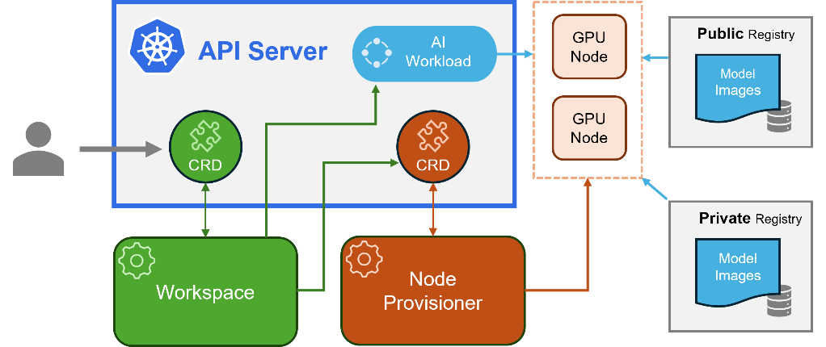
Compute Updates
Kubernetes AI toolchain operator
It is now to run specialized machine learning workloads like large language models (LLMs) on Azure Kubernetes Service (AKS) more cost-effectively and with less manual configuration.
It is based on Kaito that is an operator that automates the AI/ML inference model deployment in a Kubernetes cluster. Kaito has the following key differentiations compared to most of the mainstream model deployment methodologies built on top of virtual machine infrastructures.
Manage large model files using container images. A http server is provided to perform inference calls using the model library.
Avoid tuning deployment parameters to fit GPU hardware by providing preset configurations.
Auto-provision GPU nodes based on model requirements.
Host large model images in public Microsoft Container Registry(MCR) if the license allows.
Using Kaito, the workflow of onboarding large AI inference models in Kubernetes is largely simplified.

Slide 26
Compute Updates
Public Preview: Support for GraphQL APIs in Azure API Management Self-hosted Gateway
Customers now have the power to expose GraphQL APIs through Azure API Management's self-hosted gateway. This feature enables users to leverage Azure API Management's GraphQL capabilities, including:
Validating GraphQL requests.
Utilizing GraphQL subscriptions.*
Creating GraphQL resolvers with HTTP/Azure Cosmos DB/Azure SQL data sources.
The self-hosted gateway's GraphQL support empowers customers to deploy multiple instances of the API Gateway in non-Azure environments, like Kubernetes clusters on the edge or other cloud environments. This flexibility allows them to tap into the robust GraphQL capabilities of Azure API Management.
Announcing Azure API Management Credential Manager: Azure API Management Authorizations Renamed
MS introduced the rebranding and feature enhancements of Azure API Management's Credential Manager, formerly known as Authorizations. The updated Credential Manager now boasts additional capabilities for user-delegated permissions.
Serving as a centralized repository within API Management, the Credential Manager stores your API credentials and access tokens, playing a critical role in ensuring secure and seamless connections across all your services during API runtime. This robust system acts as a centralized hub for managing, storing, and controlling access to various API credentials, including passwords, API keys, OAuth tokens, and more, all from your API Management instance.
In the past, users were limited to using connections that were previously created with user-delegated permissions. Now, customers have the ability to facilitate the creation of connections on behalf of logged-in users on the client side. These connections empower us to present user-specific context, sparing users the need to log in repeatedly.

Slide 27
Compute Updates
GA: Azure Functions supports .NET 8 in the isolated worker model
Azure Functions now supports .NET 8 for applications using the isolated worker model. Support is available for Windows and Linux on the Consumption, Elastic Premium, and App Service plan hosting options.
Functions projects using the latest versions of Microsoft.Azure.Functions.Worker and Microsoft.Azure.Functions.Worker.Sdk can adjust their target framework setting without the need for additional changes.
These projects can be deployed to function apps configured to use .NET 8. Note that for a short period of time immediately following this announcement, Windows apps may experience additional impact from cold starts.
.NET 8 on the isolated worker model is the new recommended default for .NET function apps, and this will be reflected in tooling updates released after this announcement.
Support for .NET 8 does not currently extend to applications using the in-process model. See the August 2023 roadmap update for more information regarding support timelines.
Azure Function Flex Plan
Flex Consumption Plan is a new Azure Functions hosting plan that builds on the consumption pay for what you use, serverless billing model, and gives users more flexibility and customizability without compromising on existing capabilities. Now, customers can build serverless Functions-as-a-Service (FaaS) using Azure Functions for higher throughput, improved reliability, better performance, and additional security on their own terms.
New capabilities include fast and large elastic scale, instance size selection, private networking, availability zones, and higher concurrency control.
GA: Stateful entities in Durable Functions on the isolated worker model for .NET
The stateful entities feature of Durable Functions is now available for .NET apps on the isolated worker model. Stateful entities allow function authors to structure their code around the application state rather than just orchestration state. This supports patterns such as aggregating event data over time.

Slide 28
Compute Updates
Public Preview: Attach and VMs to and from Existing Virtual Machine Scale Sets
MS announced a possibility to attach a running Virtual Machine (VM) to an existing Virtual Machine Scale Set (VMSS) with no downtime. VMSS customers can now also detach a VM with minimal to no downtime. Attach and detach actions are available for scale sets with Flexible Orchestration Mode with a Fault Domain Count of 1.
Benefits
Let Azure do the work: Easily move from a single VM to VMSS Flex and make use of all the benefits that come from scale sets, like Autoscale, Automatic OS Upgrades, Spot Priority Mix, Instance Repairs, and Upgrade Policies.
Easily scale: By attaching an existing VM to an existing VMSS Flex, you can grow your Compute architecture without having to rebuild it from scratch.
No downtime: You can attach running VMs to a scale set with no downtime, thereby creating a frictionless experience to make use of scale sets.
Isolation: Should you need more detailed troubleshooting of a VM, you can now detach the VM to isolate it from the scale set.
Node 20 and Python 3.12 now available on App Service
MS announced that App Service now supports apps targeting Node 20 and Python 3.12 across all public regions on Linux App Service Plans.

Slide 29
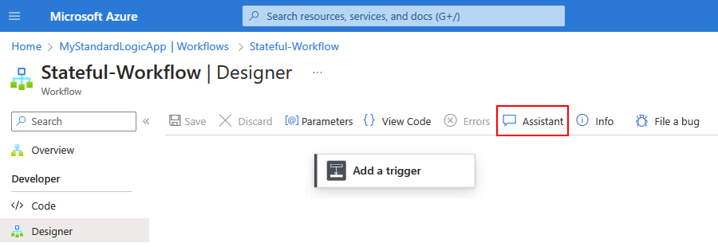
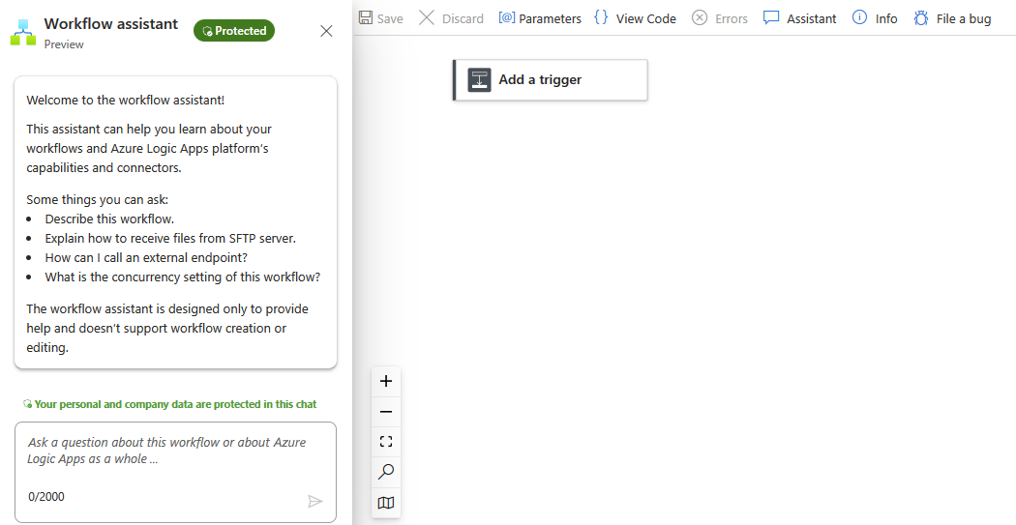
Compute Updates
Azure Logic Apps workflow assistant in public preview
Bringing the power of AI to Azure Logic Apps for the first time, this workflow assistant answers any questions you have about Azure Logic Apps from directly within the designer. Currently in public preview, this chat interface provides access to Azure Logic Apps documentation and best practices without requiring to navigate documentation or search online forums.
By harnessing Azure OpenAI and ChatGPT, the workflow assistant queries diverse knowledge sources related to Azure Logic Apps, including Microsoft Learn, connector schemas, and tech community blogs, which are processed into a vectorized format and made accessible through a backend system.
Azure Logic Apps workflow can help with:
Describe workflows built by other developers on shared workflows
Recommend and compare connectors from the over 1,000 options in Azure Logic Apps, as well as best practices for their use
Recommend patterns for workflows and integration applications, with responses that you can leverage for error handling, testing, and other optimizations
Provide step-by-step guidance on how to build workflows based on scenarios, including connectors to use, how to configure them and how to process the data
Offer contextual responses based on your workflow, allowing you to ask specific questions on how to do accomplish something in the context of an action

Slide 30
Compute Updates
Azure Logic Apps Standard VS Code Extension Installation Enhancements in public preview
Azure Logic Apps Standard empowers developers to build workflows locally using a VS Code Extension that closely mirrors the online experience provided within the portal. This enhancement bridges the gap between the development of Azure Logic Apps Standard workflows and the familiar tools and processes that developers and integration specialists are accustomed to. And now, we are simplifying the onboarding process, eliminating a series of prerequisites that were previously required before developers could dive into this experience.
Currently, in public preview starting from version 2.80.0, the installation process of the VS Code Extension for Azure Logic Apps Standard will be significantly simplified. The extension will automatically identify and install any required dependencies, such as other extensions or frameworks. This will also encompass all the necessary extensions, including the C# extension essential for debugging.
General Availability of Application Insights Enhancements for Azure Logic Apps (standard)
MS announced the general availability of Application Insights Enhancements for Azure Logic Apps (standard). This new capability gives a simplified experience for discovering insights about Logic App workflows and more control over filtering events at the source and reducing storage costs.
Existing Logic Apps will continue to use the v1 schema. By enabling this new schema, also referred to as v2, data will be emitted using a new schema. This means that if you have built custom reports that use the v1 schema, you will need to update those reports to take advantage of the new data structures.

Slide 31
Compute Updates
Announcing general availability of .NET Framework Custom Code for Azure Logic Apps (standard)
MS announced the general availability of .NET Framework Custom Code for Azure Logic Apps (standard). This capability allows customers to extend their low-code solutions with the power of custom code.
In addition, this new capability provides the following benefits:
A no-cliffs extensibility capability to our low-code offering, giving developers the flexibility and control needed to solve the toughest integration problems
No additional service plans required, deploy your custom code alongside your workflows
A local debug experience, in VS Code, which allows you to step through your workflows and code in the same debugging session
Support for BizTalk migration scenarios, allowing customers to lift and shift their custom .NET Framework investments from on-premises to the cloud
General Availability of Azure Logic Apps' New Data Mapper for Visual Studio Code
Data Mapper is Azure Logic Apps' new visual data transformation tool. Now, in general availability, as a Visual Studio Code extension, it can create and edit maps between source and target schemas. In order to exchange messages between different XML or JSON formats in an Azure Logic Apps workflow—especially when the source and target schemas have different structures—the data must be transformed from one format to another. Data Mapper serves this purpose by helping you visually create these mappings while also handling transformations in a singular tool.
Data Mapper provides a modernized experience for XSLT authoring and transformation that includes drag and drop gestures, a prebuilt functions library, and manual testing. You can use the extension to create maps for XML to XML, JSON to JSON, XML to JSON, and JSON to XML transformations. Once created, these maps can be called from workflows in your logic app project in both Visual Studio Code and deployed to Azure.

Slide 32
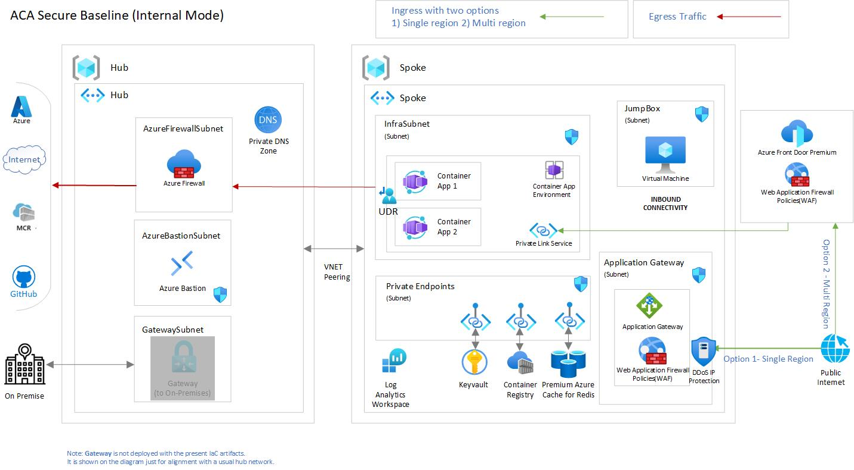
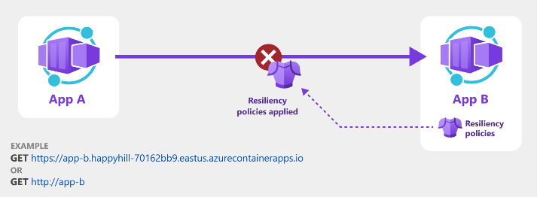
Compute Updates
Public preview: Vector database add-ons for Azure Container Apps
Azure Container Apps is providing add-ons for three of the most popular opensource vector database variants, namely Qdrant, Milvus and Weaviate, to get started quickly and try out innovative use cases before going into production.
With the native Azure Container Apps integration, and its scale to zero capabilities, these add-ons make it fast, easy, and affordable to try things out.
Public preview: Policy-driven resiliency in Azure Container Apps
The new resiliency feature enables seamlessly recover from service-to-service request and outbound dependency failures just by adding simple policies. Several policies are built in for retries, back-offs and circuit breakers. The policies are also customizable to meet unique workload needs.
Behind the scenes, the resiliency feature is powered by Dapr resiliency, however, it requires no special deployment, coding or knowledge of Dapr.
Generally available: Azure Container Apps Landing Zone Accelerator
Azure Container Apps Landing Zone Accelerator is now generally available with the latest workload profiles and Container Apps Jobs resources. With Azure Container Apps landing zone accelerator, it is possible to build a production grade secured infrastructure at an enterprise scale to deploy fully managed, cloud-native apps and microservices.
Landing zone accelerators provide architectural guidance, reference architecture, reference implementations and automation packaged to deploy workload platforms on Azure at scale.

Slide 33
Compute Updates
Public preview: Azure Container Apps adds native support for CNCF Buildpacks to automatically containerize your code
Cloud build feature, now in public preview, adds support for CNCF Buildpacks to Azure Container Apps. You no longer have the overhead of creating containers for existing or new applications.
With this feature, Azure Container Apps automatically builds and package the application code for deployment. Additionally, Container Apps will make it easier to keep these applications patched by providing on-demand patches which can be applied from the client.
Public preview: Dedicated GPU workload profiles
GPU workloads are now available in public preview in Azure Container Apps. Run machine learning models with Azure Container Apps as a target compute platform as you build event driven intelligent applications to train model or derive data driven insights.
Container Apps support GPU compute in their dedicated workload profiles to unlock machine learning computing for event driven workloads.
This features allows use of the NC A100 v4 series GPUs that are optimized for real-world Azure Applied AI training and batch inference workloads. GPU workload profiles are offered as part of the Dedicated Plan and only supported in the Workload Profiles type environment. Pricing details are available in the Dedicated plan.

Slide 34
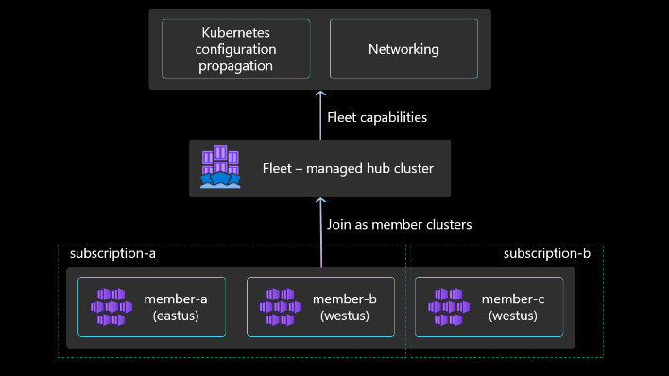
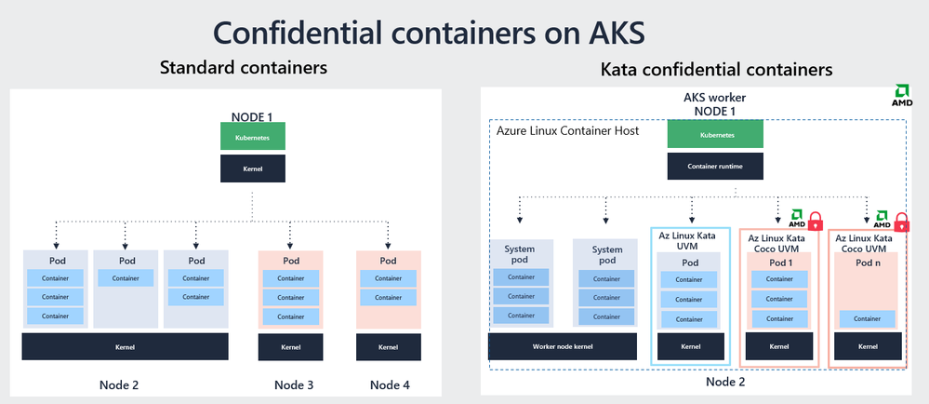
Compute Updates
GA: Azure Kubernetes Fleet Manager
Azure Kubernetes Fleet Manager (Fleet) enables at-scale management of multiple Azure Kubernetes Service (AKS) clusters. Fleet supports the following scenarios:
Create a Fleet resource and group AKS clusters as member clusters.
Orchestrate Kubernetes version and node image upgrades across multiple clusters by using update runs, stages, and groups.
Create Kubernetes resource objects on the Fleet resource's hub cluster and control their propagation to member clusters (preview).
Export and import services between member clusters, and load balance incoming L4 traffic across service endpoints on multiple clusters (preview).
Public preview: Confidential containers on Azure Kubernetes Service (AKS)
Confidential containers on Azure Kubernetes Service (AKS), leveraging the Kata confidential containers open-source project, is now in public preview. It enables to run individual pods in their own trusted execution environment (TEE) with hardware-based confidentiality and integrity protections for your container workloads while in use in memory.
Confidential containers on AKS is supported as a new SKU that you can select when deploying your workload and will provide you with the following benefits for workloads processing highly sensitive data:

Slide 35
Compute Updates
Announcing Conversational Diagnostics (Preview) on Windows App Services
MS announced the Conversational Diagnostics (Preview), a new feature in Windows App Services that leverages the powerful capabilities of OpenAI to take problem-solving to the next level. With this feature, can engage in a conversational dialogue to accurately identify the issue with Windows Web Apps, and receive a clear set of solutions, documentation, and diagnostics to help resolve the issue.

Slide 36
Storage & Data

Slide 37
Storage & Data Updates
GA: Ultra Disk performance updates
The maximum provisioned IOPS and provisioned throughput on Azure Ultra Disk Storage is increased to 400,000 IOPS and 10,000 MB/s per disk. A single Ultra Disk can achieve the maximum IOPS and throughput of the largest Azure Virtual Machines (VMs), reducing the complexity of managing multiple disks striped together. The increased performance can also be leveraged by multiple Azure VMs when the Ultra Disk is configured as a shared disk.
Azure Container Storage is now available with Azure Linux container host
Azure Container Storage in preview, provides highly scalable, cost-effective volumes for production-scale stateful container applications seamlessly via Azure Kubernetes Service (AKS) CLI. It is now possible to leverage Azure Container Storage with AKS clusters or nodepools using Azure Linux container host. To achieve this, you can simply create a new managed Kubernetes cluster by selecting the OS SKU as Azure Linux and enabling Azure Container Storage, directly as part of the AKS cluster create or update CLI experience.

Slide 38
Storage & Data Updates
What is new in file shares for enterprise workloads
Faster metadata operations with Azure Files (Preview): it is now possible to leverage reduced metadata latency by 30-40%, varying with the IO patterns.
Coming soon: Larger and faster volumes with Azure NetApp Files (GA): It is now possible in preview, create volumes of up to 500TiB in size, with increased performance for read, write, and metadata operations.
SMB continuous availability with Azure NetApp Files (GA): For SMB volumes, it is possible to enabled Continuous Availability for transparent failover.
Coming soon:
Cross-zone replication with Azure NetApp Files (GA)
Geo-redundancy for large file shares: on the standard tiers with Azure Files (GA): It is now possible to enable geo-redundancy and large file shares (up to 100TiB capacity) on the same storage account to significantly increase your standard file share capacity and performance limits while benefiting from geo-redundancy.
NFS snapshots with Azure Files (GA): It is now possible to protect data from corruption or accidental deletion with file share snapshots.
Customer-managed keys for encryption at rest with Azure NetApp Files (GA): It is now possible in preview, use Azure Key Vault to store and manage own encryption keys for data at rest, adding an extra layer of security for data.
Double encryption at-rest with Azure NetApp Files (GA): it is now possible, in preview, enable multiple independent encryption layers for data at rest, reducing the risk of data breaches due to compromised keys, encryption errors, or algorithm flaws.
Standard storage with cool access with Azure NetApp Files (Preview): It is now possible to configure a standard capacity pool with cool access. Cool access moves cold (infrequently accessed) data transparently to a managed Azure storage account to reduce costs
User and group quotas with Azure NetApp Files (GA): It is now possible to restrict the storage space that a user or group can use within a specific volume, for both NFS and SMB protocols

Slide 39
Databases

Slide 40
Databases Updates
General availability: Free tier on Azure Cosmos DB for MongoDB vCore
The free tier of Azure Cosmos DB for MongoDB vCore makes it easy to start, develop, and experiment with applications. It is possible to even manage small production workloads without expenses. You're eligible for one free tier account per supported region, and your free tier benefits last for the life of your account. When your data and ambitions grow, you can seamlessly transition to a paid tier.
Key benefits
Zero Upfront Costs
Effortless Onboarding
Generous Storage (32GB)
Seamless Upgrade Path
Public preview: Priority-based execution in Azure Cosmos DB
Leverage priority-based execution to prioritize critical requests during high traffic situations, potentially throttling lower priority ones to be retried according to configured retry policy.
To use this feature, simply define the priority level for requests sent to Azure Cosmos DB using client SDK libraries. Depending on the specified priority, if there are more requests than the allocated RU/s, Azure Cosmos DB will throttle lower-priority requests first, ensuring high-priority requests are processed on a best-effort basis.
Priority-based execution feature doesn't guarantee always throttling low priority requests in favor of high priority ones. This operates on best-effort basis and there are no SLA's linked to the performance of the feature.
Public preview: Dynamic scaling per partition and per region
MS announced new public preview feature that allow: autoscale, dynamic scaling per partition and per region. This dynamic scaling will provide the flexibility to independently scale non-uniform workloads resulting in greater efficiency and savings.
Dynamic scaling per partition and per region allows each partition and each region to scale up and down independently based on usage. Previously, all partitions scaled uniformly based on the most active partition. This works well for scenarios with even traffic across all partitions. However, it could cause unnecessary scaling if only a single or a few partitions are active. Database workloads that have a highly trafficked primary region can take advantage of this autoscale improvement to save on cost.

Slide 41
Databases Updates
General availability: Vector search in Azure Cosmos DB for MongoDB vCore
MS announced that vector search in Azure Cosmos DB for MongoDB vCore is now generally available. This new feature enables to conduct vector similarity search seamlessly within existing database. By integrating vector search capabilities natively, you can unlock the full potential of data in applications built on the OpenAI API, as well as custom-built solutions that leverage vector embeddings for semantic search, recommendations, and more. This all-in-one solution streamlines the process of building AI-based applications with own data by reducing complexity and improving efficiency. Experience the future of MongoDB workloads with vector search in Azure Cosmos DB for MongoDB vCore.
Vector search is a method that helps to find similar items based on their data characteristics rather than by exact matches on a property field. This technique is useful in applications such as searching for similar text, finding related images, making recommendations, or even detecting anomalies. It works by taking the vector representations (lists of numbers) of your data that you created by using a machine learning model by using an embeddings API. Examples of embeddings APIs are Azure OpenAI Embeddings or Hugging Face on Azur
General Availability: Azure Cosmos DB for MongoDB vCore
Azure Cosmos DB for MongoDB vCore offers an integrated, performant, and cost efficient fully-managed database for MongoDB workloads, including AI-powered workloads such as chatbots. You can continue using the MongoDB tools, drivers, and SDKs you're familiar with while boosting developer efficiency through deep integration with Azure products.
Benefit from the flexibility of Azure Cosmos DB for MongoDB vCore. A shard key is not required until your databases surpass terabytes of data. Pricing is based on vCPUs and disks, and there is no limit on the number of collections in the database. Unlock the full potential of your data using native vector search in this all-in-one solution.
Furthermore, Azure Cosmos DB for MongoDB vCore simply works. You can easily migrate existing applications or build new applications with a familiar architecture that matches expectations.

Slide 42
Databases Updates
General availability: Azure AI Advantage for Azure Cosmos DB
MS announced the Azure AI Advantage customer offer.
This offer provides new and existing Azure AI customers with a limited time opportunity to use Azure Cosmos DB as the underlying database for up to 90 days.
MS provides 40,000 Request Units per second (RU/s) of Azure Cosmos DB for 90 days. This is the equivalent of up to $6,000 in savings for a customer.
To be eligible for the offer, customers must use GitHub Copilot or Azure AI services in their subscription and create a new Azure Cosmos DB database account and must enroll in offer within 30 days of account creation. After the 90 day trial period, customers will continue to run their application at the normal Azure Cosmos DB pricing.
Public preview: Cross-account container copy for Azure Cosmos DB NoSQL API
MS announced that the preview of cross-account container copy functionality is now available for NoSQL API in Azure Cosmos DB. With this feature, it is possible to seamlessly migrate data from one container to another across different Azure Cosmos DB accounts in offline mode. This includes the ability to migrate data between serverless and provisioned accounts.
Public Preview: Azure Cosmos DB Migration for MongoDB extension - Azure Cosmos DB for MongoDB vCore migration capability
The Azure Cosmos DB Migration for MongoDB extension in Azure Data Studio helps assess a MongoDB workload for migrating to Azure Cosmos DB for MongoDB. It is possible to use this extension to run an end-to-end assessment on workload and find out the actions that may need to take to seamlessly migrate workloads on Azure Cosmos DB. During the assessment of a MongoDB endpoint, the extension reports all the discovered resources.
Public preview: Microsoft Copilot for Azure capability now available in Azure Cosmos DB
The public preview of the copilot capability in Azure Cosmos DB enables to turn data questions into Azure Cosmos DB NoSQL queries using the Azure Cosmos DB Data Explorer.
This new capability uses the power of Azure OpenAI to increase productivity and reduce time spent on building queries. It also provides English language explanations of the generated query, increasing interpretability and making it easier to validate the accuracy of the AI-generated query.

Slide 43
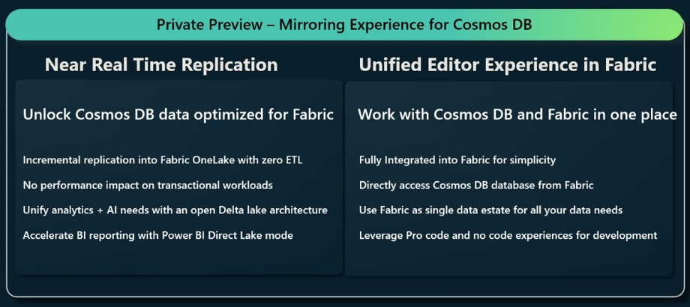
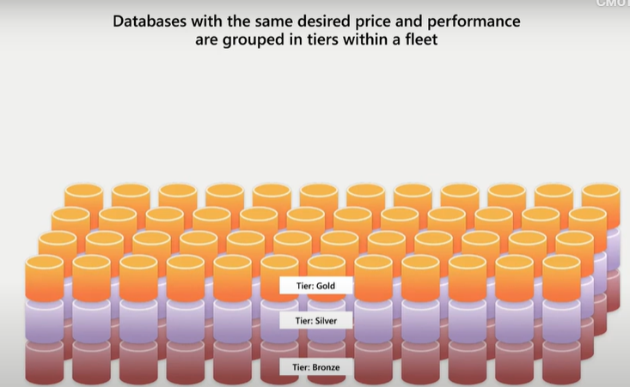
Databases Updates
Azure Cosmos DB Mirroring in Microsoft Fabric – Private Preview
MS announced the private preview availability of mirroring Azure Cosmos DB databases in Microsoft Fabric. Mirroring provides a modern way of accessing Azure Cosmos DB databases in Microsoft Fabric, helping unify your data estate, thereby eliminating data silos.
With just a few clicks, it is now possible to bring Azure Cosmos DB databases into Microsoft Fabric, for rich business insights using Fabric’s built-in advanced analytics and AI capabilities. Your Cosmos DB operational data is seamlessly and incrementally replicated into Fabric OneLake in near real-time.
Introducing Azure Database Fleet Manager
Azure Database Fleet Manager is a built-in, first-class offering in Azure Database Platform based on the operational experience of the largest 1st party SaaS offerings from Microsoft (like SharePoint Online, Dynamics 365 and Power Platform) that removes the complexity of managing the end-to-end lifecycle of their operational databases.
Primary goal of Azure Database Fleet Manager is to dramatically simplify provisioning and management of database fleets of all sizes. To achieve this goal, MS introduced a number of abstractions that hide underlying platform entities like logical servers and elastic pools that, while providing a great experience for small sets of databases, are introducing several constraints and limits

Slide 44
Databases Updates
Public preview: Azure Database for PostgreSQL extension for Azure AI
We announced the preview of the new azure_ai extension which enables you to integrate Azure AI services with your operational data.
azure_ai extension allows :
Generate embeddings from within the database with a single line of SQL code invoking a UDF.
Call various service from SQL with a simple function call enabling scenarios such as:
Sentiment Analysis
Language detection
Summarization
PII information detection
Key phase extractions
Harness the power of large language models (LLMS) alongside your operational data in PostgreSQL.
Public Preview: Long Term Retention for Azure Database for PostgreSQL - Flexible Server
Azure Database for PostgreSQL - Flexible Server now offers a backup solution for supporting long term data retention and improved compliance for PostgreSQL databases using Azure Backup. In preview, you now can leverage a rich set of capabilities such as flexible database backup policies, management of individual backups, and streamlined configuration. Additionally, you can add policies to backup and retain data for up to 10 years for compliance purposes.
Postgres 16 support in Flexible Server – General Availability
On September 14th, The PostgreSQL Global Development Group announced the release of PostgreSQL 16.
Near Zero Downtime Scaling – General Availability
Near Zero Downtime Scaling is a groundbreaking feature designed to minimize disruptions when modifying storage and compute tiers. When adjustments are made, such as modifying the number of vCores or changing the compute tier, the server undergoes a restart to apply the new configuration. During this transition, new connections cannot be established. In traditional scaling methods, this process could take anywhere from 2 to 10 minutes, but with Near Zero Downtime Scaling, this duration has been reduced to less than 30 seconds.

Slide 45
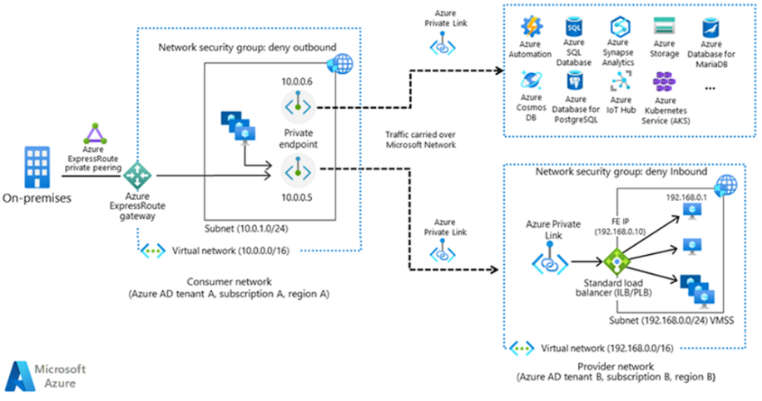
Databases Updates
New Postgres Extensions: azure_storage & tds_fdw
To simplify loading and exporting data between Azure cloud storage and Postgres, MS announced the general availability of the azure_storage extension for Postgres.
Also, to access data in Microsoft SQL, we’re pleased to announce the availability of tds_fdw which enables customers to use a foreign data wrapper to query data stored in Microsoft SQL databases.
New Regions - General Availability
MS announced the general availability of the Israel Central region for Azure Database for PostgreSQL - Flexible Server.
Premium SSD v2 – Public Preview
Flexible Server in Azure Database for PostgreSQL now provides a new storage option that supports up to 80K IOPS, 64 TB storage, and 1,200 MB/s throughput. The Premium SSD v2 option (in Preview) enables to tailor IOPS and storage to workload needs and adjust the settings anytime, without any interruption. You can also resize storage allocation by as little as 1 GB to achieve the optimal fit for your database.
Introducing Private Link based networking with Azure Database for PostgreSQL – Flexible Server
MS announced support for Azure Private Link for private networking with Azure Database for PostgreSQL - Flexible server in Public Preview, in addition to already existing networking capabilities provided by VNET injection. This has been a widely asked feature from our customers and will add security and flexibility to the networking stack of PostgreSQL Flexible Server.

Slide 46
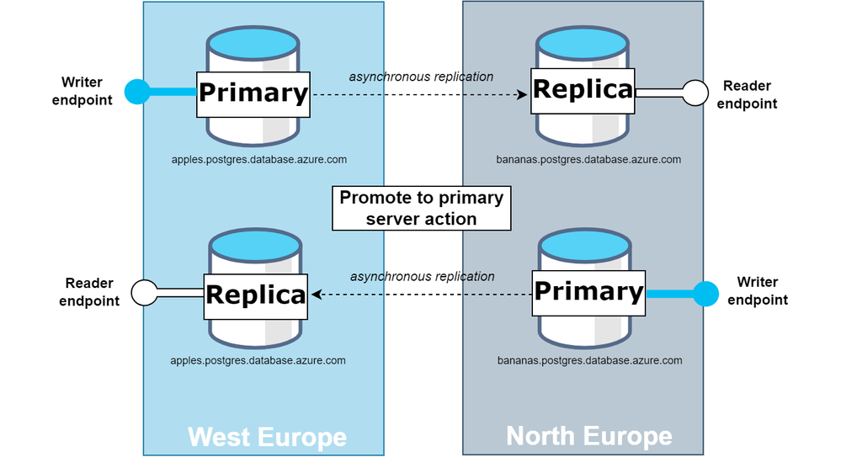
Databases Updates
Multi-Region Disaster Recovery (GeoDR) – Public Preview
Mission-critical applications require robust high availability and disaster recovery capabilities. MS announced that Multi-Region Disaster Recovery, often referred to as GeoDR, is now in public preview for Azure Database for PostgreSQL - Flexible Server. Using GeoDR, it is possible to failover to a different region under a single Virtual Endpoint.
Virtual Endpoints - database's steadfast links that remain unchanged, irrespective of role swaps. As a result, the writer endpoint will always connect to the current primary server, and the reader endpoint will point to the current replica. This feature ensures that, even after a promotion event, application's connection strings remain valid, eliminating the need for manual updates and thereby streamlining your disaster recovery operations.
Promote to primary server - allows for a swift and straightforward swap of roles between primary database and its replica, ensuring continuous operations with minimal interruption.
Storage IOPS Separation – Public Preview
Azure Database for PostgreSQL – Flexible Server supports the provisioning of additional IOPS. This feature enables to provision additional IOPS above the complimentary IOPS limit. Using this feature, it is possible to increase or decrease the number of IOPS provisioned based on your workload requirements at any time.
The minimum and maximum IOPS are determined by the selected compute size.

Slide 47
Databases Updates
General Availability: Lower pricing for Azure SQL Database Hyperscale expected in December 2023
From December 15, 2023, it will be possible to build new, highly scalable cloud applications on Azure SQL Database Hyperscale at the price of commercial open-source databases.
As a result, it allows to save up to 35% on compute bill and invest in other resources to build AI-ready cloud applications of any size and IO requirement.
The new pricing will also apply to storage. You will be charged only for the storage used by the database. There will be no charges for IO operations.
General Availability: November 2022 Feature Wave for Azure SQL Managed Instance
Enjoy faster instance provisioning with 30 minute provisioning for the first instance in a subnet.
Improve the resiliency of your instances with zone redundancy for Business Critical instances.
Optimize your costs by starting and stopping your General Purpose instances at your discretion.
Run distributed transactions in mixed environments through Microsoft Distributed Transaction Coordinator (MSDTC).
Public Preview: Azure SQL updates for mid-November 2023
In mid-November 2023, the following updates and enhancements were made to Azure SQL:
Improve the performance and scalability of Azure SQL Database Hyperscale elastic pools with the new premium-series, and memory optimized premium-series hardware options.
Enable disaster recovery for Azure SQL Database at lower cost using standby replica which does not incur license costs.
Replicate Azure SQL Managed Instance databases to SQL Server 2022 and in case of disaster, failover online SQL Server 2022 databases to Azure SQL Managed Instance using the link feature.
General availability: Azure SQL updates for mid-November 2023
1 year capacity reservations for the Premium service tier of Azure SQL database.
Enable Always Encrypted with secure enclaves that require stronger security protection of hardware enclave and have CPU or memory-heavy workload requirements using new DC-series databases with up to 40 vCores.
Azure SQL Managed Instance business critical improvements including more vCores, doubled max log rate, better storage-to-vCore ratio, and more click stops. Learn More.
Bring the benefits of Always Encrypted to all Azure SQL Database offerings with software-based Always Encrypted with virtualization-based security (VBS) enclaves.
Make your data tamper-proof and establish trust with ledger in Azure SQL Managed Instance.

Slide 48
Databases Updates
Public preview: Bring enhanced manageability to your SQL Server anywhere with Azure Arc
Introducing a new set of cloud-native features for on-premises or multicloud SQL Server workloads. With SQL Server enabled by Azure Arc it is possible to benefit from out-of-box monitoring services; enhanced manageability of critical database operations such as Always On availability groups and failover cluster instances; and Extended Security Updates. All work together to bring better visibility, flexibility, and security to SQL Server, on-premises or across multi-cloud.
Ledger in Azure SQL Managed Instance now generally available
MS announced that ledger in Azure SQL Managed Instance is now generally available! This feature enables to store and protect sensitive data in a tamper-evident and cryptographically verifiable way, using the same familiar SQL interface. Ledger is designed to meet the highest standards of security and compliance, and it is ideal for scenarios such as financial transactions, healthcare records, audit logs, and more. With ledger, you can enjoy the benefits of a fully managed and scalable cloud database service, while ensuring the integrity and immutability of your data. The data is centrally managed, and you can cryptographically attest to other parties, such as auditors or other business parties, that your data is trusted and isn’t tampered with.
General availability: Azure SQL Database Always Encrypted with virtualization-based security (VBS) enclaves
Always Encrypted is a family of industry-leading data protection features that provide a separation between those who own the data and can view it, and those who manage the data but should have no access. Until now, Always Encrypted with secure enclaves in Azure SQL Database relied on a hardware solution, Intel Software Guard Extensions (SGX) hardware enclaves. With the release of Azure SQL Database Always Encrypted with virtualization-based security (VBS) this dependency is removed.
Unlike Intel SGX, virtualization-based security (VBS) is a software-based solution with no hardware dependency. This allows you to bring the benefits of Always Encrypted with secure enclaves to all Azure SQL Database offerings. You can use the feature with a compute tier (provisioned or serverless), a purchasing model (vCore or DTU), a compute size (currently, up to 128 vCores), and a region that best matches your workload requirements. And, since VBS enclaves are available in existing hardware offerings, they come with no extra cost.

Slide 49
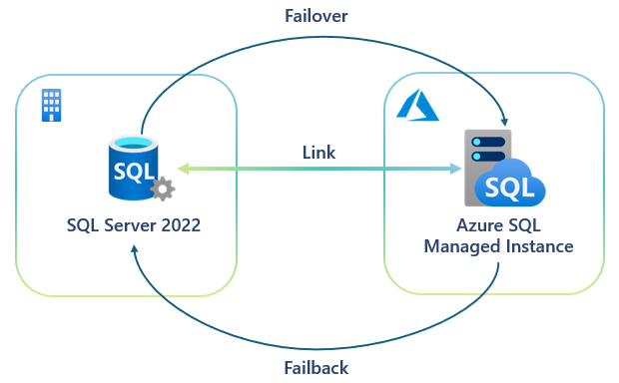
Databases Updates
New user interface experience for Azure SQL migration extension
MS announced the new user interface (UI) for the Azure Database Migration Service's Azure Data Studio extension - Azure SQL Migration in release 1.5.0. The new UI provides an intuitive experience that is easy to use and navigate. It is designed to help you migrate seamlessly and efficiently. Highlights of the new UI are:
Revamped assessment results to show migration readiness of SQL source against the Azure SQL targets.
A redesigned summary of assessment to display source databases migration readiness status.
An improved target selection making it easier to compare Azure SQL targets.
Experience a more productive and effortless migration workflow to Azure SQL targets with the new Azure SQL migration UI.
Public preview: Online Disaster recovery between SQL Server 2022 and Azure SQL Managed Instance
MS announced the public preview of online disaster recovery between SQL Server 2022 and Azure SQL Managed Instance with the link feature in Azure SQL Managed Instance.
The link feature connects SQL Server 2022, hosted anywhere and the fully managed platform as a service (PaaS) service, Azure SQL Managed Instance, providing unprecedented hybrid flexibility and database mobility. With near real-time data replication to Azure using Always On technology, it is now possible to scale workloads or analytics to read-only secondaries in Azure to take advantage of a fully managed database platform, performance, and scale.

Slide 50
Databases Updates
Public Preview: Azure Managed Instance for Apache Cassandra Feature Updates
MS released several preview features to Azure Managed Instance for Apache Cassandra that will enable to:
Build next generation AI apps with vector search in Cassandra 5.0.
Handle major Cassandra upgrades seamlessly with turnkey major version upgrades.
Deploy multi-region clusters effortlessly with turnkey replication.
Carry out live migrations easily with turnkey hybrid cluster setup.
Reduce tail latencies and improve performance with write-through cache.
Enhanced Performance in Additional Regions: Azure Synapse Analytics Spark Boosted by up to 77%
MS announced substantial improvements that could increase Spark performance by as much as 77%.
Performance Metrics
Internal testing, utilizing the 1TB TPC-H industry standard benchmark, indicates performance gains of up to 77%. It's important to note that individual workloads may vary, but the enhancements are designed to benefit all Azure Synapse Analytics Spark users.
Technological Foundations
This performance uptick is attributable to our transition to the latest Azure v5 Virtual Machines. These VMs bring improved CPU performance, increased SSD throughput, and elevated remote storage IOPS.

Slide 51
Integration

Slide 52
Integration Updates
Generally available: Partitioned namespaces for Azure Service Bus Premium
MS Announced the General Availability of partitioned namespaces feature, which allows the use of partitioning for the premium messaging tier. This means that the overall throughput of a partitioned entity is no longer limited by the performance of a single message broker.
Partitioned namespaces work in close conjunction with scaling through Messaging Units, as the configured MUs on a namespace are equally distributed across the different partitions. Currently it is possible to scale up to 4 partitions, and as each partition can scale from 1MU to 16MU, this means we can scale up to a total of 64MU.
There are some differences between partitioning in the standard and premium SKUs. First, the number of partitions is configured during namespace creation on the premium SKU, while partitioned namespaces in the standard SKU comes with a fixed number of partitions. Second, unlike the standard SKU, partitioned namespaces in the premium SKU do not allow non-partitioned entities in them.
To enable partitions, select to enable partitioning and set the number of partitions during creation of a new namespace. Please note that it is not possible to change the number of partitions after creation.
An updated SLA for Azure Service Bus Premium
If you create a Premium namespace with the new partitioned entities feature enabled, in a region where Availability Zones is available, MS will provide an SLA of 99.99%.
MQTT broker feature, PubSub capabilities now available for Azure Event Grid
To support the growing demand for connectivity, integration and analytics between Internet of Things (IoT) devices and cloud-based services, Azure Event Grid’s new MQTT broker feature is now generally available.
This enables bi-directional communication between MQTT clients at scale, enabling one-to-many, many-to-one and one-to-one messaging patterns using MQTT v3.1.1 and MQTT v5 protocols.
This new capability combined with support for pull delivery (now also GA) and push delivery of events via HTTP means that Event Grid customers benefit from flexible consumption patterns, at scale.
To support customer demand for scalability, Event Grid has also doubled capacity to 40 throughput units in each namespace.
Further enabling ingestion pipelines, Event Grid namespaces can also be used to push events at scale to Azure Event Hubs. This feature is in public preview.

Slide 53
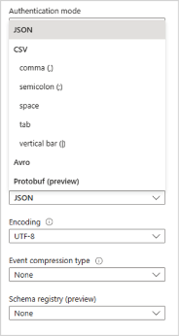
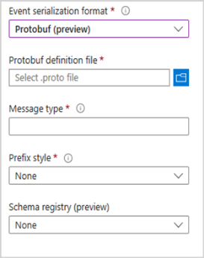
Integration Updates
Introducing Azure Integration Environment & Business Process Tracking (Public Preview)
MS introduced Azure Integration Environment, a new unified experience that helps customers manage and monitor their integration resources effectively.
There are two core components that make up this new unified experience:
Integration Environment provides a common area where your resources can be managed.
Business Process Tracking allows organizations to set business context over the transactions that are being processed by Azure Logic Apps.
The resource types that are currently supported include:
Azure Logic Apps (Standard)
Azure API Management APIs
Azure Service Bus queues and topics
Announcing the Public Preview of Kafka Input and Output with Azure Stream Analytics
MS announced the public preview of Kafka Input and Output with Azure Stream Analytics!
Limitation:
The minimum version of Kafka that you can configure Azure Stream Analytics to connect to is version 0.10.
Public Preview: Protocol Buffers (Protobuf) with Azure Stream Analytics
Azure Stream Analytics now allows you to seamlessly process events in the Protobuf data format using a built-in Protocol Buffer deserializer.
Protobuf is Google’s language-neutral, platform-neutral, extensible mechanism for serializing structured data into binary format. This allows for many performance benefits, such as reducing the bandwidth needed to send messages, compact storage, and cross-language compatibility.

Slide 54
ML & AI & IOT

Slide 55
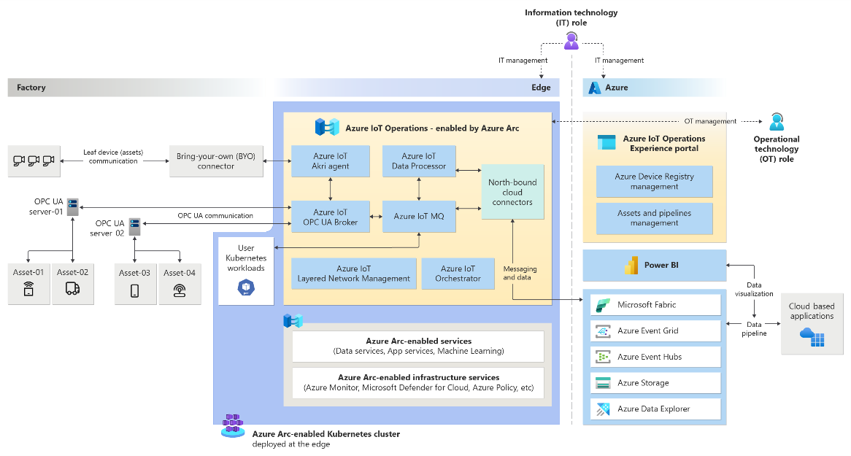
ML & AI & IOT Updates
Public Preview: Azure IoT Operations
Azure IoT Operations Preview is a unified data plane for the edge. It's composed of a set of modular, scalable, and highly available data services that run on Azure Arc-enabled edge Kubernetes clusters. It enables data capture from various different systems and integrates with data modeling applications such as Microsoft Fabric to help organizations deploy the industrial metaverse.
Is built from ground up by using Kubernetes native applications.
Includes an industrial-grade, edge-native MQTT broker that powers event-driven architectures.
Is highly extensible, scalable, resilient, and secure.
Lets manage all edge services from the cloud by using Azure Arc.
Can integrate customer workloads into the platform to create a unified solution.
Supports GitOps configuration as code for deployment and updates.
Natively integrates with Azure Event Hubs, Azure Event Grid's MQTT broker, and Microsoft Fabric in the cloud.

Slide 56
ML & AI & IOT Updates
Public Preview: Azure Open AI “Use your data” integration with Azure Cosmos DB for MongoDB vCore
The "Use your data" feature in Azure OpenAI Studio now integrates with Azure Cosmos DB for MongoDB vCore. Harness the power of Retrieval Augmented Generation and vector search effortlessly, bringing data directly into OpenAI models.
Running models on data empowers to build complex and personalized LLM-powered applications tailored to your scenarios. It is possible to customize conversational AI content to exact needs.
Azure AI Studio
Azure AI Studio is a unified development platform for generative AI solutions. It provides a comprehensive set of tools and capabilities to help developers build, test, and deploy generative AI models, including:
A visual interface for creating prompt flows: This allows developers to connect large language models, prompts, and Python tools through a visualized graph.
A library of pre-trained generative AI models: This includes models for text generation, translation, and question answering.
Tools for evaluating and debugging prompt flows: This allows developers to test and refine their models before deploying them to production.
A deployment pipeline for deploying prompt flows to Azure Kubernetes Service (AKS): This allows developers to easily deploy their models to production and scale them up or down as needed.
Azure AI Studio is a powerful tool that can be used to build a wide variety of generative AI solutions. Some examples of use cases include:
Creating custom copilots: These are AI-powered assistants that can help users with tasks such as writing code, answering questions, and debugging software.
Enhancing search: Generative AI models can be used to improve the relevance and accuracy of search results.
Developing call center solutions: Generative AI models can be used to create chatbots and virtual assistants that can answer customer questions, provide support, and resolve issues.
Building bots and bespoke applications: Generative AI models can be used to create a wide variety of bots and bespoke applications, such as financial chatbots, educational chatbots, and customer service chatbots.

Slide 57
ML & AI & IOT Updates
Azure Machine Learning - Public Preview for November
Three features now available in public preview enable to choose which models/datasets are right for you without having to run any job, seamlessly read/write data from a Fabric datastore; and Model-as-a-Service with inference APIs and hosted fine-tuning.
Model Benchmarks for Curated Models: It is now possible to view the model leaderboard table with models from the Model Catalog, publicly available datasets, and pre-populated metrics.
Create a Fabric OneLake Lakehouse Datastore type: It is now possible to directly consume data assets from a Fabric Lakehouse in AzureML by creating a OneLake Lakehouse datastore type.
Model-as-a-Service with inference APIs and hosted fine-tuning: It enables machine learning professionals to easily integrate foundation models such as Llama 2 from Meta as an application programming interface (API) endpoint to their applications and fine-tune models without having to manage the underlying GPU infrastructure.
Azure Machine Learning - General Availability for November
Five features now available in GA enable to search thousands of OSS LLMs, provide a feature set specification and let the system handle the rest, and lower. compute management overhead and setup costs. You can also now deploy complex compute graphs under batch endpoints, and use one platform to build, tune, evaluate, deploy, and test AI workflows.
Model Catalog: It allows to discover, customize and operationalize large foundation models without the hassle of managing infrastructure or software dependencies.
Managed Feature Store: It is now possible to experiment and ship models faster, increase reliability of your models and reduce your operational costs.
Model Training with Serverless Compute: It is now possible to focus on building ML models without needing to learn how to set up compute infra.
Deploy pipelines and components under Batch Endpoints: It is now possible to deploy multiple versions of the pipelines using multiple deployments under the same endpoint and switch between them without disturbing your downstream consumers
Build high quality intelligent applications with Prompt flow: It is now possible to quickly build a workflow that connects different data sources with LLM for building intelligent applications.

Slide 58
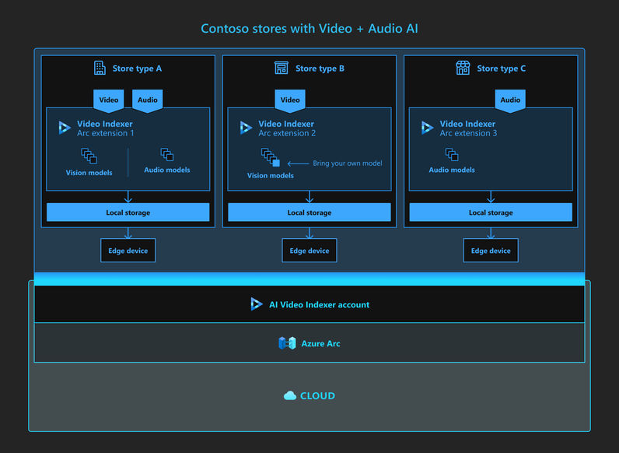
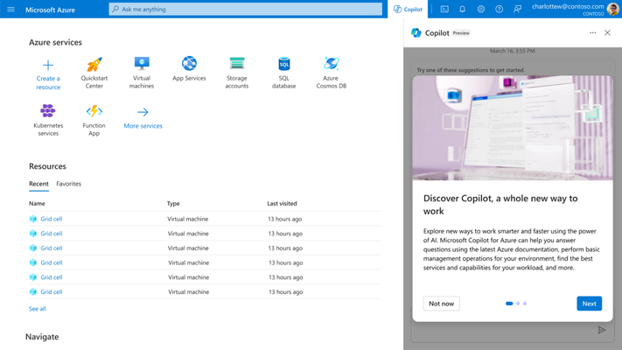
ML & AI & IOT Updates
Public preview: Microsoft Copilot for Azure
Microsoft Copilot for Azure is now in preview. With Copilot for Azures users can gain new insights into their workloads, unlock untapped Azure functionality and orchestrate tasks across both cloud and edge. Copilot leverages Large Language Models (LLMs), the Azure control plane and insights about a user’s Azure and Arc-enabled assets. All of this is carried out within the framework of Azure’s steadfast commitment to safeguarding the customer’s data security and privacy.
Announcing Preview of Azure AI Video Indexer Cloud-to-Edge Version
MS announced the public preview of the Azure AI Video Indexer powered by Azure Arc. This innovative hybrid cloud to edge solution enables our customers to run detection and classification-based Video AIs at the content location.

Slide 59
DevOps

Slide 60
DevOps Updates
General availability: Start and stop load (Azure Load Testing) faults in Azure Chaos Studio
Outages do not happen in a vacuum. More often than not, they occur when customer traffic is coming into system. Synthetic load is vastly important for chaos testing workflows as it allows to more closely mimic infrastructure’s production conditions.
Now it is possible to add load to chaos experiment directly in Chaos Studio’s Experiment designer. Moreover, the ability to choose when exactly in experiment you’d like to start and stop load allows for more sophisticated experimentation scenarios.
Azure Chaos Studio is now generally available
The general availability of Azure Chaos Studios allows users to boost their resilience against faults and failures by gaining a better understanding of application resiliency, conducting experiments with a wide variety of agent- and service-based faults, and maintaining production quality through continuous validation. Chaos Studio enables users to assess how applications respond to real-world disruptions like network delays, unexpected storage failures, expired secrets or even complete datacenter outages. Templates in Chaos Studio allow users, in a matter of minutes, to test the resilience of their Azure resources by providing a set of pre-filled experiments based on common outage scenarios. Dynamic targets functionality allows users to select experiment targets by using KQL queries, rather than static list selection, allowing more sophisticated fault injection scenarios to be created.
Experiment templates now available in Azure Chaos Studio
Microsoft released two templates below:
Chaos Studio’s Azure Active Directory (AAD) Outage template allows to induce an outage on AAD instance by modifying network security group rules (NSG Security Rule (version 1.1)) fault.
Chaos Studio’s Availability Zone Down template allows you to take down specific (or all) availability zones within your VMSS instance (with autoscale disabled). This template utilizes both the “Disable Autoscale” and “VMSS Shutdown (version 2.0)” faults to perform the outage scenario.

Slide 61
DevOps Updates
Introducing New Capabilities in Microsoft Dev Box
Microsoft Dev Box introduced a new capabilities to support greater customization and simplify Dev Box setup for development teams. These new features, now in public preview, focus on increasing developer productivity and satisfaction.
Dev box limits: Limit the number of dev boxes each developer can create within a project to help manage costs and ensure efficient use of resources.
Microsoft-hosted networks: Simplify network setup and eliminate the need to create, configure, and secure a virtual network with Microsoft-hosted networks.
Quick create template: Get a complete, step-by-step guide from initial admin configuration through Dev Box deployment.
Dev Box-compatible Docker Desktop images: Leverage preconfigured images that have everything needed to build containers with Visual Studio and Docker Desktop.
Introducing New Capabilities in Azure Deployment Environments
Azure Deployment Environments is adding new capabilities to deliver an end-to-end developer experience and the ability to control costs by configuring auto-delete schedules. These capabilities empower enterprises to enhance developer productivity and more effectively manage cloud resource costs.
Integration with Azure Developer CLI (azd): Enable developers to provision application infrastructure and more easily deploy app code onto provisioned infrastructure directly from the Azure Developer CLI. This feature is in public preview.
Scheduled auto-deletion: Configure schedules that delete deployment environments and associated resources when they are no longer needed. This feature is generally available.
Bicep: Deployment Environments now provides native support for Bicep, a domain-specific language (DSL) that helps platform engineers more efficiently deploy their Azure resources. Bicep also enables admins to drive even more consistency with their IaC templates, and notably, offers a first-class authoring experience when creating Bicep files in VS Code. Bicep support is in private preview,

Slide 62
Miscellaneous

Slide 63
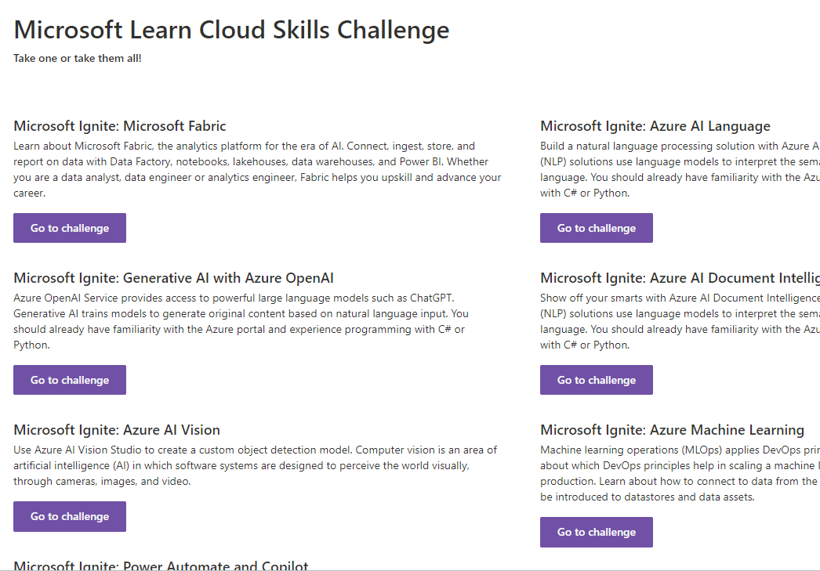
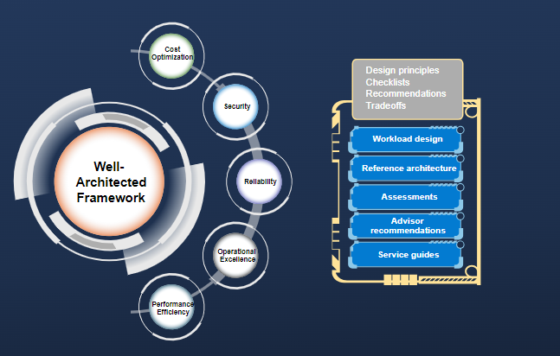
Miscellaneous Updates
Microsoft Ignite Skills Challenges
Deepening Well-Architected guidance for workloads hosted on Azure
Microsoft have updated and reviewed the documentation for the WAF

Slide 64
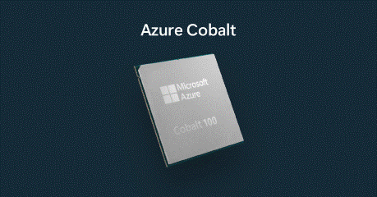

Miscellaneous Updates
Microsoft Azure Cobalt
Cobalt 100 CPU is built on Arm architecture, a type of energy-efficient chip design, and optimized to deliver greater efficiency and performance in cloud native offerings.
Cobalt is the first CPU designed by us, specifically for the Microsoft Cloud. This 64-bit 128-core ARM-based chip is the fastest of any cloud provider. It’s already powering parts of Microsoft Teams, Azure Communications Services, as well as Azure SQL.
Microsoft Azure Maia AI Accelerator
A new in-house chip was released. The Microsoft Azure Maia AI Accelerator, optimized for artificial intelligence (AI) tasks and generative AI
Maia 100 AI Accelerator will power some of the largest internal AI workloads running on Microsoft Azure
This chip is manufactured on a 5-nanometer process and has 105 billion transistors, making it one of the largest chips that can be made with current technology

Slide 65
Information

Slide 66
Information
Azure Times GitHub Repo

Slide 67
Questions

